Slide 1
GitHub: Making/Receiving Changes and Syncing Repositories
Daniel Ablog
January 22, 2015

Slide 2
Basic Requirements
To contribute to a shared project and make/receive changes you must first:
Setup a GitHub account at https://github.com
Download GitHub desktop at https://github.com/ near the bottom of the page.
Be added as a “collaborator” for the project by the “owner” or “author” of the forked repository (i.e. ask Dr. Chris Lum to be added to the project)
Know how to change, sync, and upload changes to and from your local repository to the shared master repository (i.e. follow steps on the next few slides)

Slide 3
“Cloning” Repository for Own Usage in Desktop and Making Changes

Slide 4
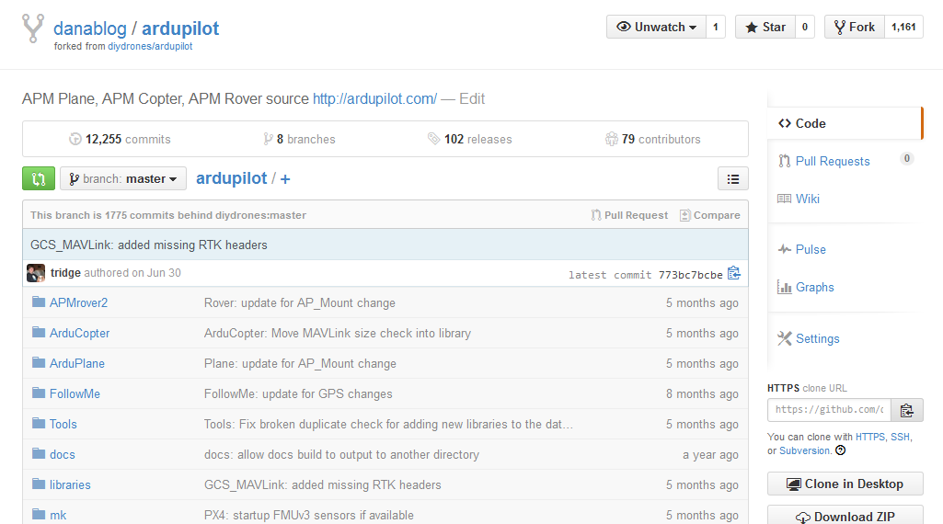
Making Changes in Desktop Repository
Download the latest version of GitHub Desktop.
“Fork” a branch of the master repository to your personal online account via online GitHub. Note: This may not be needed if you were added as a collaborator.
To fork a copy of the repository to your personal account from online GitHub

Slide 5
Making Changes in Desktop Repository (Cont.)
Open and sign in to your GitHub Desktop client on your computer.
Verify that the “forked” repository appears on the left hand side of the window.
Note: If it doesn’t show up, access your online GitHub account and open the repository you are looking for. Click on “clone” at the bottom right corner and the repository should show up in your local GitHub Desktop client (might need to hit “refresh” or “sync” in the desktop client). It will ask for the place where you want the copy of the source code. Once this is completed, you have successfully cloned the repository to your desktop and can make changes (skip steps 5 and 6 on the next few slides)

Slide 6
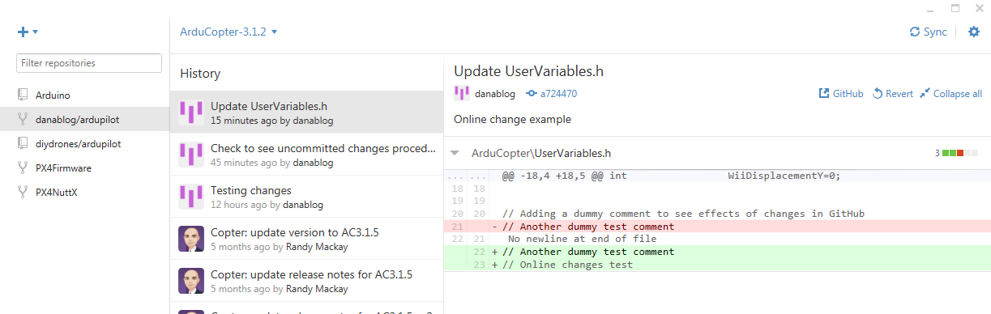
Making Changes in Desktop Repository (Cont.)
Click on the “plus” to open cloning/creating options
Click on “plus” to open clone window
“Forked” Repository appears in local GitHub Desktop

Slide 7
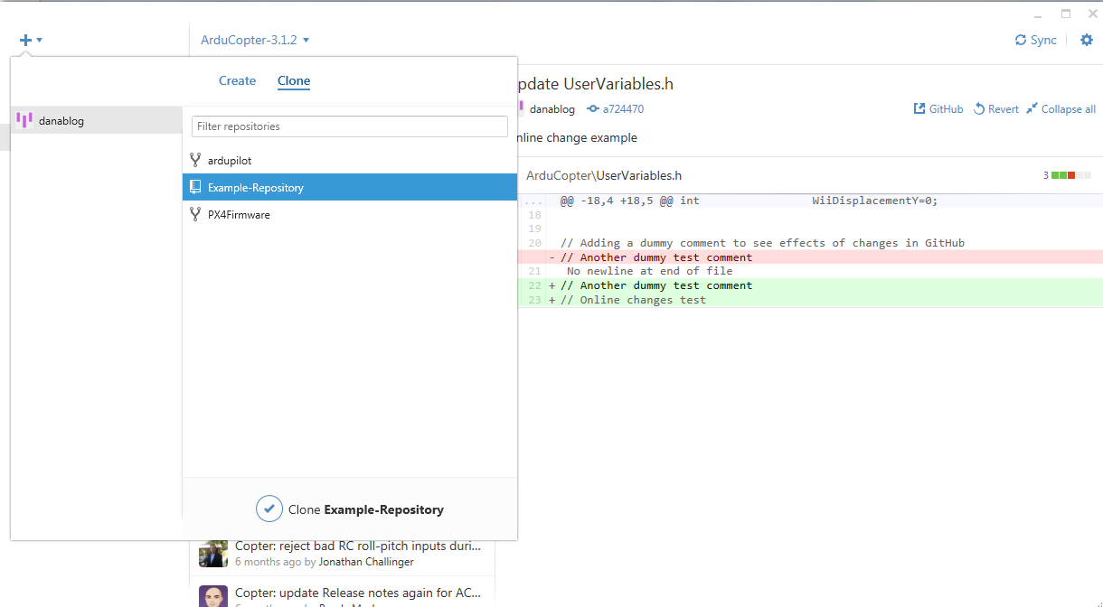
Making Changes in Desktop Repository (Cont.)
“Clone” the “forked” repository to your desktop
Click on “clone” tab
“Clone” the repository

Slide 8
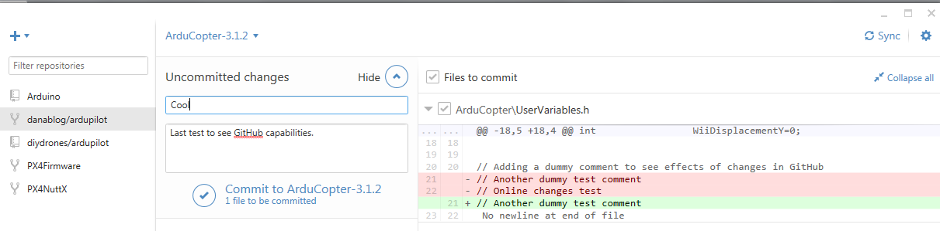
Making Changes in Desktop Repository (Cont.)
Locate desired file in “cloned” location in Windows Explorer and edit file.
After editing, GitHub/GitHub Desktop notices any changes made to the local file and previews the changes in the local client
Much like Perforce, must provide a description to the changes made.
Hit “commit” and the changes are then made.
Must sync desktop GitHub with online cloud to update files.
GitHub Desktop tracks changes and allows for descriptions
To sync reposito-ries
Finalize changes and commit

Slide 9
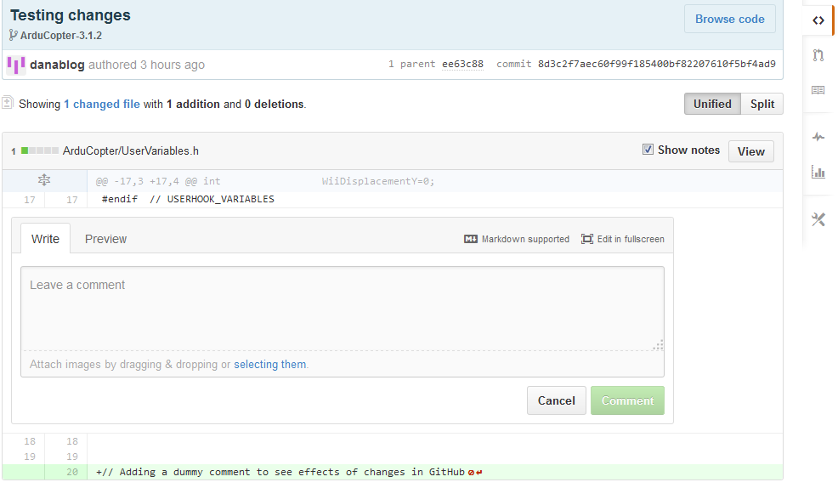
Making Changes in Desktop Repository (Cont.)
Changes are now visible on the local clone and can be seen by all collaborators..
Can compare changed and unchanged files
Changes are highlighted and located in GitHub. Verifies change.

Slide 10
Set “Upstream” Remote Repository as diydrones/ardupilot master

Slide 11
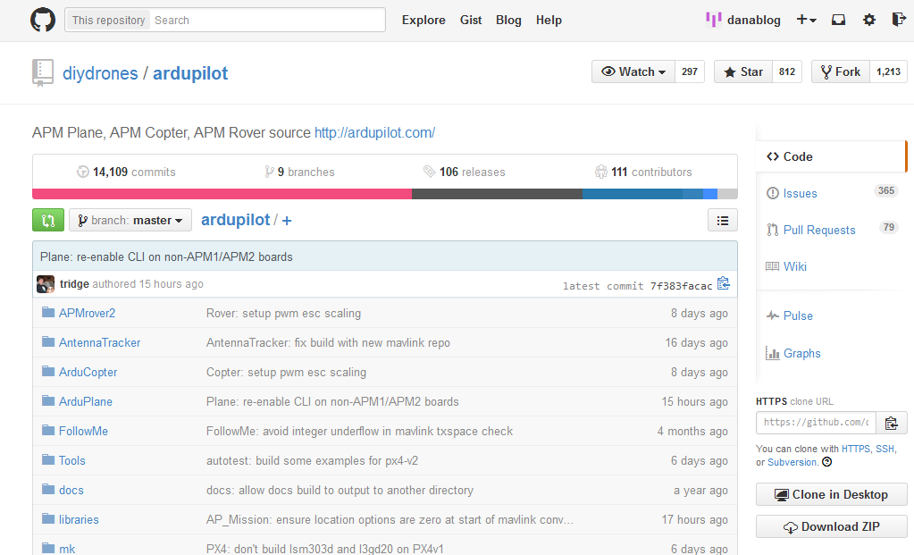
Set “Upstream” Remote Repo
Go to GitHub online and access the original “upstream” master repository.
Copy the clone URL for the original repository. Note: you may need to write it down if copy/paste doesn’t work on your computer.
To copy URL

Slide 12
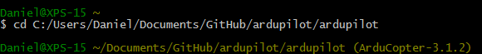
Set “Upstream” Remote Repo (cont.)
Open GitHub command line in your desktop.
Either GitBash or GitShell
Change working directory to location of local clone by typing: cd working_directory (working_directory is your current clone location). Make sure to use FORWARD SLASHES. In my case, it was: C:/Users/Daniel/Documents/GitHub/ardupilot/ardupilot
Should get this after changing working directory, except it should read “Master” in parentheses

Slide 13
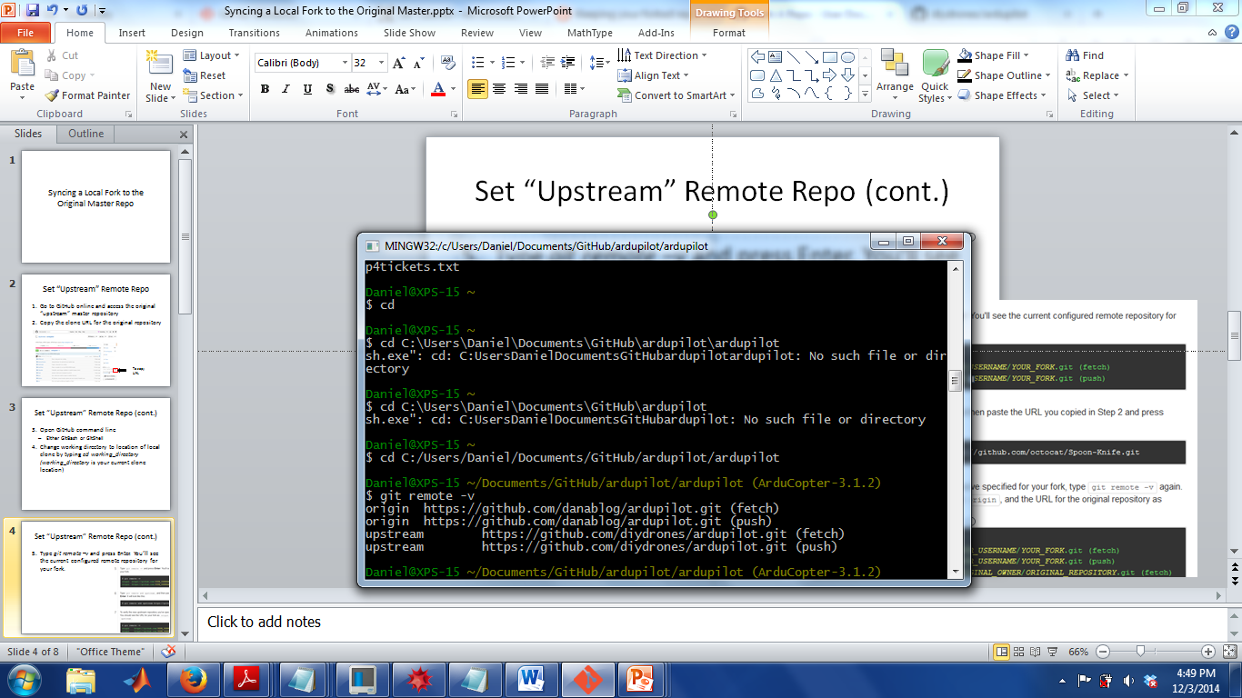
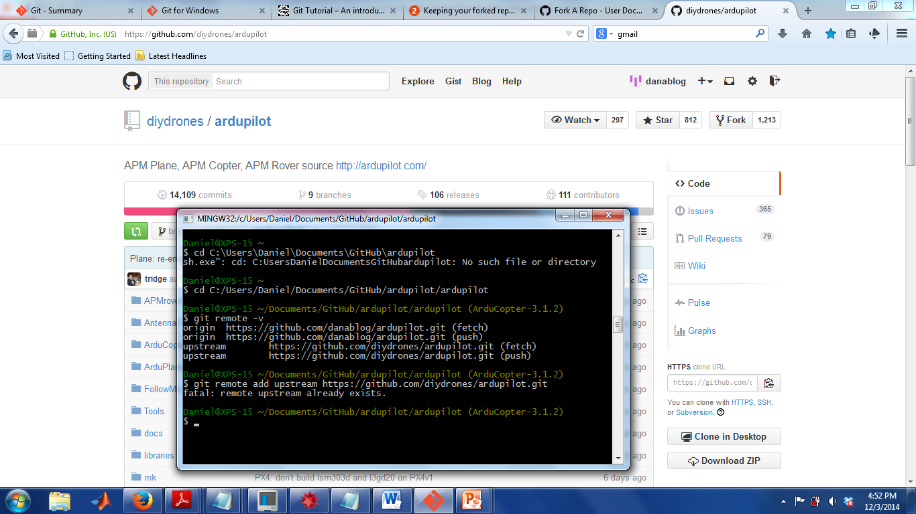
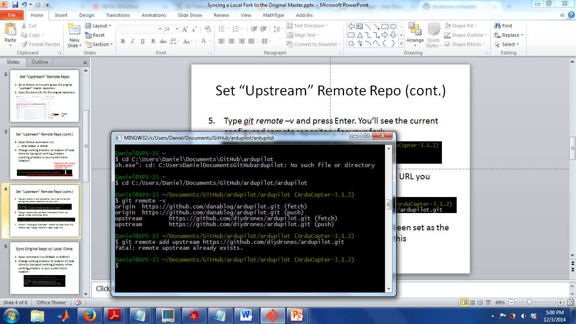
Set “Upstream” Remote Repo (cont.)
Type git remote –v and press Enter. You’ll see the current configured remote repository for your fork.
Type git remote add upstream, then paste the URL you copied in Step 2 and press Enter.
To verify the original “upstream” master has been set as the remote repo, type git remote –v again to get this

Slide 14
Receive Changes/Bug Fixes from diydrones/ardupilot master repository

Slide 15
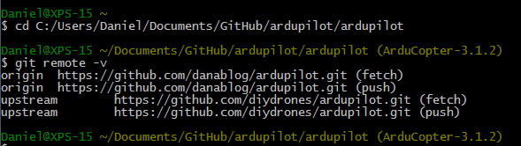
Sync Local Clone w/ Upstream Repo
Open command line (GitBash or GitShell)
Change working directory to location of local clone by typing command: cd C:/Working_Directory, where Working_Directory is your current clone location. Make sure to use FORWARD SLASHES. For example, in my case, it was: C:/Users/Daniel/Documents/GitHub/ardupilot/ardupilot

Slide 16
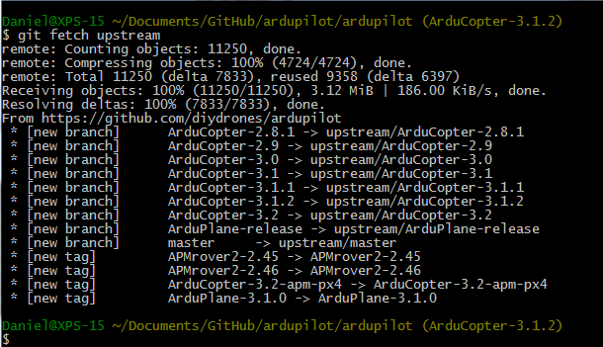
Sync Local Clone w/ Upstream Repo (cont.)
Fetch the branches and their respective commits from the upstream repository by using the command: git fetch upstream

Slide 17
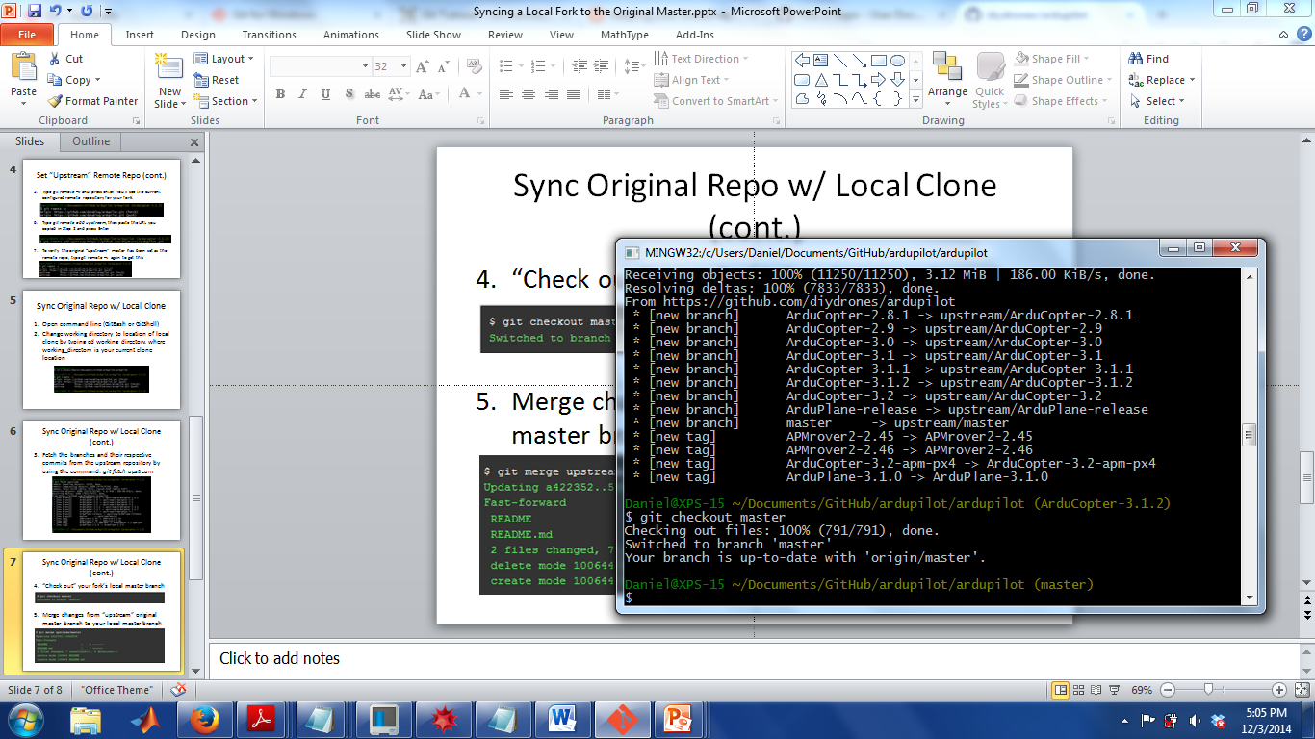
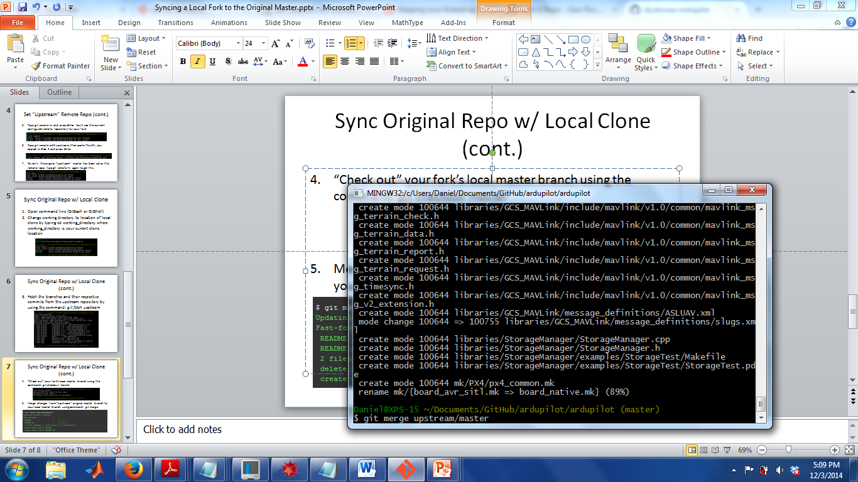
Sync Local Clone w/ Upstream Repo (cont.)
“Check out” your fork’s local master branch using the command: git checkout master
Merge changes from “upstream” original master branch to your local master branch using command: git merge upstream/master
All commits and updates from the original “upstream” master repository have been added to your local clone

Slide 18
Send Your Changes Up to the uwafsl/ardupilot master Repository

Slide 19
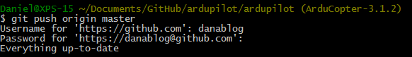
Sync Online Fork w/ Cloned Repo
Now that you’ve synced the local “cloned” branch with the “remote” upstream repo
In Git Bash, type in the command line:
git push origin master
The online forked repository is now synced with the “cloned” repository you have on your desktop and everyone in the project can see your changes.

Slide 20
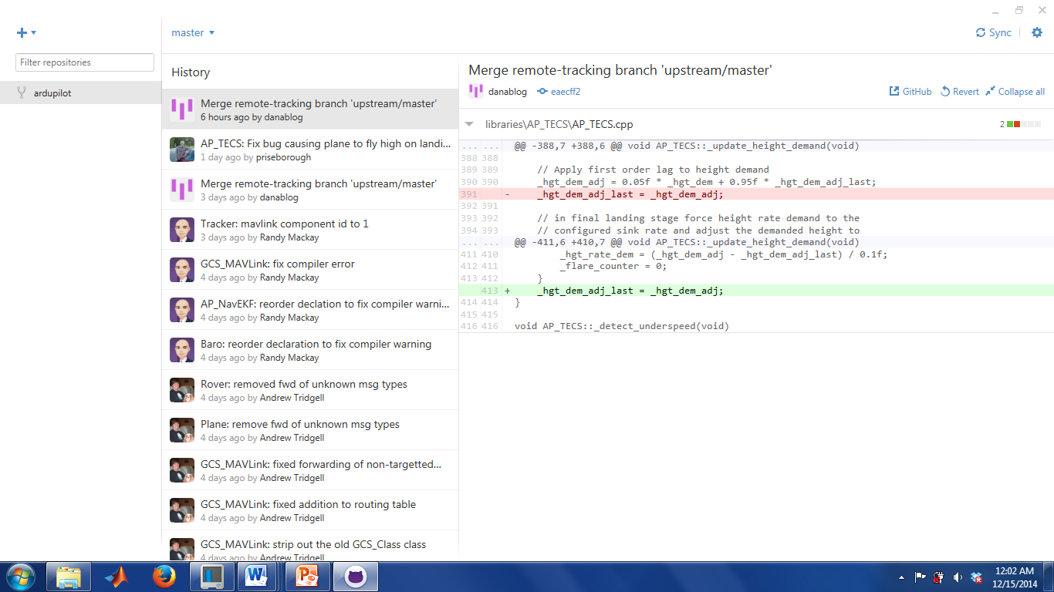
Sync Online Fork w/ Cloned Repo (cont.)
An alternative way to sync online repo with local repo is to go to the GitHub desktop client and click on “sync” at the top of the window.

